Slide 1
INTERPROCESS COMMUNICATION

Slide 2
Introduction
Interprocess communication in the Internet provides both datagram and stream communication.
The interprocess communication primitives support point-to-point communication, yet it is equally useful to be able to send a message from one sender to a group of receivers.
Multicast is an important requirement for distributed applications and must be provided even if underlying support for IP multicast is not available. This is typically provided by an overlay network constructed on top of the underlying TCP/IP network.
Overlay networks can also provide support for file sharing, enhanced reliability and content distribution.

Slide 3
Introduction (cont.)
In this chapter we will see how middleware and application programs can use transport level protocols UDP and TCP.
The application program interface to UDP provides a message passing abstraction – the simplest form of interprocess communication. This enables a sending process to transmit a single message to a receiving process.
The independent packets containing these messages are called datagrams. In the Java and UNIX APIs, the sender specifies the destination using a socket – an indirect reference to a particular port used by the destination process at a destination computer.
The application program interface to TCP provides the abstraction of a two-way stream between pairs of processes. The information communicated consists of a stream of data items with no message boundaries.

Slide 4
Introduction (cont.)
Streams provide a building block for producer-consumer communication.
A producer and a consumer form a pair of processes in which the role of the first is to produce data items and the role of the second is to consume them.
The data items sent by the producer to the consumer are queued on arrival at the receiving host until the consumer is ready to receive them. The consumer must wait when no data items are available. The producer must wait if the storage used to hold the queued data items is exhausted.

Slide 5
The API for the Internet Protocols
We will discuss the general characteristics of interprocess communication and then discuss the Internet protocols as an example, explaining how programmers can use them, either by means of UDP messages or through TCP streams.
This section revisits the message communication operations send and receive, with a discussion of how they synchronize with one another and how message destinations are specified in a distributed system. The next section introduces sockets, which are used in the application programming interface to UDP and TCP. Thereafter, another section discusses UDP and its API in Java. Finally, TCP and its API in Java will be discussed. The APIs for Java are object oriented but are similar to the ones designed originally in the Berkeley BSD 4.x UNIX operating system; a case study on the latter is available on the web site for the book [www.cdk5.net/ipc]. Readers studying the programming examples in this section should consult the online Java documentation or Flanagan [2002] for the full specification of the classes discussed, which are in the package java.net.

Slide 6
Characteristics of Interprocess Communication
Message passing between a pair of processes can be supported by two message communication operations, send and receive, defined in terms of destinations and messages.
To communicate, one process sends a message (a sequence of bytes) to a destination and another process at the destination receives the message. This activity involves the communication of data from the sending process to the receiving process and may involve the synchronization of the two processes.

Slide 7
Synchronous and Asynchronous Communication
A queue is associated with each message destination. Sending processes cause messages to be added to remote queues and receiving processes remove messages from local queues. Communication between the sending and receiving processes may be either synchronous or asynchronous.
In the synchronous form of communication, the sending and receiving processes synchronize at every message. In this case, both send and receive are blocking operations. Whenever a send is issued the sending process (or thread) is blocked until the corresponding receive is issued. Whenever a receive is issued by a process (or thread), it blocks until a message arrives.

Slide 8
Synchronous and Asynchronous Communication (cont.)
In the asynchronous form of communication, the use of the send operation is non-blocking in that the sending process is allowed to proceed as soon as the message has been copied to a local buffer, and the transmission of the message proceeds in parallel with the sending process.
The receive operation can have blocking and non-blocking variants. In the non-blocking variant, the receiving process proceeds with its program after issuing a receive operation, which provides a buffer to be filled in the background, but it must separately receive notification that its buffer has been filled, by polling or interrupt.

Slide 9
Synchronous and Asynchronous Communication (cont.)
In a system environment such as Java, which supports multiple threads in a single process, the blocking receive has no disadvantages, for it can be issued by one thread while other threads in the process remain active, and the simplicity of synchronizing the receiving threads with the incoming message is a substantial advantage.
Non-blocking communication appears to be more efficient, but it involves extra complexity in the receiving process associated with the need to acquire the incoming message out of its flow of control.
For these reasons, today’s systems do not generally provide the non-blocking form of receive.

Slide 10
Message Destinations
Previous chapter explained that in the Internet protocols, messages are sent to (Internet address, local port) pairs. A local port is a message destination within a computer, specified as an integer.
A port has exactly one receiver (multicast ports are an exception) but can have many senders. Processes may use multiple ports to receive messages. Any process that knows the number of a port can send a message to it. Servers generally publicize their port numbers for use by clients.
If the client uses a fixed Internet address to refer to a service, then that service must always run on the same computer for its address to remain valid.

Slide 11
Message Destinations (cont.)
This can be avoided by using the following approach to providing location transparency:
Client programs refer to services by name and use a name server or to translate their names into server locations at runtime. This allows services to be relocated but not to migrate – that is, to be moved while the system is running.

Slide 12
Reliability
Chapter 2 defined reliable communication in terms of validity and integrity.
As far as the validity property is concerned, a point-to-point message service can be described as reliable if messages are guaranteed to be delivered despite a ‘reasonable’ number of packets being dropped or lost.
In contrast, a point-to-point message service can be described as unreliable if messages are not guaranteed to be delivered in the face of even a single packet dropped or lost.
For integrity, messages must arrive uncorrupted and without duplication.

Slide 13
Ordering
Some applications require that messages be delivered in sender order– that is, the order in which they were transmitted by the sender.
The delivery of messages out of sender order is regarded as a failure by such applications.

Slide 14
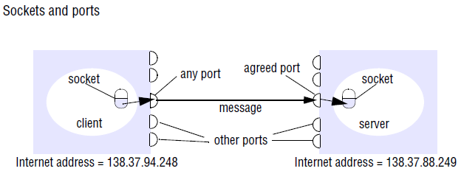
Sockets
Both forms of communication (UDP and TCP) use the socket abstraction, which provides an endpoint for communication between processes. Sockets originate from BSD UNIX but are also present in most other versions of UNIX, including Linux as well as Windows and the Macintosh OS. Interprocess communication consists of transmitting a message between a socket in one process and a socket in another process, as illustrated in Figure.

Slide 15
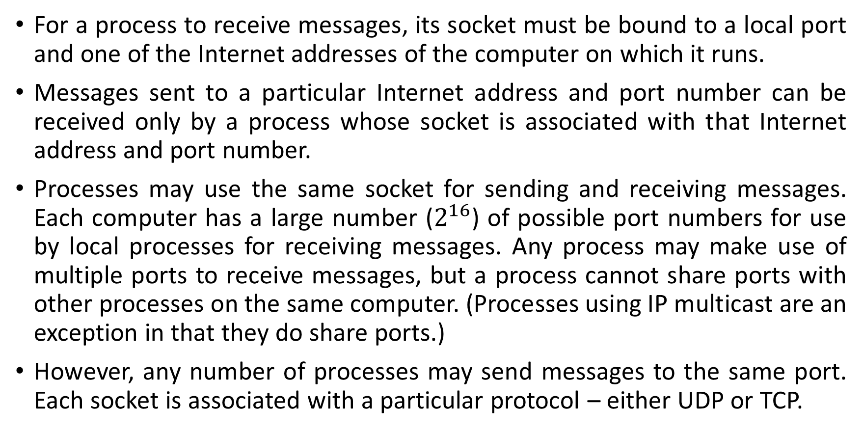
Sockets (cont.)
For a process to receive messages, its socket must be bound to a local port and one of the Internet addresses of the computer on which it runs.
Messages sent to a particular Internet address and port number can be received only by a process whose socket is associated with that Internet address and port number.
Processes may use the same socket for sending and receiving messages. Each computer has a large number ($2^{16}$) of possible port numbers for use by local processes for receiving messages. Any process may make use of multiple ports to receive messages, but a process cannot share ports with other processes on the same computer. (Processes using IP multicast are an exception in that they do share ports.)
However, any number of processes may send messages to the same port. Each socket is associated with a particular protocol – either UDP or TCP.

Slide 16
Java API for Internet Addresses
As the IP packets underlying UDP and TCP are sent to Internet addresses, Java provides a class, InetAddress, that represents Internet addresses. Users of this class refer to computers by Domain Name System (DNS) hostnames. For example, instances of InetAddress that contain Internet addresses can be created by calling a static method of InetAddress, giving a DNS hostname as the argument. The method uses the DNS to get the corresponding Internet address. For example, to get an object representing the Internet address of the host whose DNS name is bruno.dcs.qmul.ac.uk, use:
InetAddress aComputer = InetAddress.getByName("bruno.dcs.qmul.ac.uk");
This method can throw an UnknownHostException. Note that the user of the class does not need to state the explicit value of an Internet address. In fact, the class encapsulates the details of the representation of Internet addresses. Thus the interface for this class is not dependent on the number of bytes needed to represent Internet addresses – 4 bytes in IPv4 and 16 bytes in IPv6.

Slide 17
UDP Datagram Communication
A datagram sent by UDP is transmitted from a sending process to a receiving process without acknowledgement or retries. If a failure occurs, the message may not arrive.
To send or receive messages, a process must first create a socket bound to an Internet address of the local host and a local port. A server will bind its socket to a server port – one that it makes known to clients so that they can send messages to it.
A client binds its socket to any free local port. The receive method returns the Internet address and port of the sender, in addition to the message, allowing the recipient to send a reply.

Slide 18
Issues in UDP Datagram Communication (cont.)
Message size:
The receiving process needs to specify an array of bytes of a particular size in which to receive a message. If the message is too big for the array, it is truncated on arrival.
The underlying IP protocol allows packet lengths of up to 216 bytes, which includes the headers as well as the message. However, most environments impose a size restriction of 8 kilobytes. Any application requiring messages larger than the maximum must fragment them into chunks of that size.
Generally, an application, for example DNS, will decide on a size that is not excessively large but is adequate for its intended use.

Slide 19
Issues in UDP Datagram Communication (cont.)
Blocking:
Sockets normally provide non-blocking sends and blocking receives for datagram communication. The send operation returns when it has handed the message to the underlying UDP and IP protocols, which are responsible for transmitting it to its destination.
On arrival, the message is placed in a queue for the socket that is bound to the destination port. The message can be collected from the queue by an outstanding or future invocation of receive on that socket. Messages are discarded at the destination if no process already has a socket bound to the destination port. The method receive blocks until a datagram is received, unless a timeout has been set on the socket. If the process that invokes the receive method has other work to do while waiting for the message, it should arrange to use a separate thread. Threads are discussed in Chapter 7. For example, when a server receives a message from a client, the message may specify work to do, in which case the server will use separate threads to do the work and to wait for messages from other clients.

Slide 20
Issues in UDP Datagram Communication (cont.)
Timeouts:
The receive that blocks forever is suitable for use by a server that is waiting to receive requests from its clients. But in some programs, it is not appropriate that a process that has invoked a receive operation should wait indefinitely in situations where the sending process may have crashed or the expected message may have been lost.
To allow for such requirements, timeouts can be set on sockets. Choosing an appropriate timeout interval is difficult, but it should be fairly large in comparison with the time required to transmit a message.

Slide 21
Issues in UDP Datagram Communication (cont.)
Receive from any:
The receive method does not specify an origin for messages. Instead, an invocation of receive gets a message addressed to its socket from any origin.
The receive method returns the Internet address and local port of the sender, allowing the recipient to check where the message came from.
It is possible to connect a datagram socket to a particular remote port and Internet address, in which case the socket is only able to send messages to and receive messages from that address.

Slide 22
Failure Model for UDP Datagrams
A failure model for communication channels and defines reliable communication in terms of two properties: integrity and validity.
The integrity property requires that messages should not be corrupted or duplicated. The use of a checksum ensures that there is a negligible probability that any message received is corrupted. UDP datagrams suffer from the following failures:
Omission failures: Messages may be dropped occasionally, either because of a checksum error or because no buffer space is available at the source or destination. To simplify the discussion, we regard send-omission and receive-omission failures as omission failures in the communication channel.
Ordering: Messages can sometimes be delivered out of sender order.
Applications using UDP datagrams are left to provide their own checks to achieve the quality of reliable communication they require. A reliable delivery service may be constructed from one that suffers from omission failures by the use of acknowledgements.

Slide 23
Use of UDP
For some applications, it is acceptable to use a service that is liable to occasional omission failures.
For example, the Domain Name System, which looks up DNS names in the Internet, is implemented over UDP. Voice over IP (VOIP) also runs over UDP.
UDP datagrams are sometimes an attractive choice because they do not suffer from the overheads associated with guaranteed message delivery. There are three main sources of overhead:
the need to store state information at the source and destination;
the transmission of extra messages;
latency for the sender.

Slide 24

Java API for UDP Datagrams
The Java API provides datagram communication by means of two classes: DatagramPacket and DatagramSocket.
DatagramPacket: This class provides a constructor that makes an instance out of an array of bytes comprising a message, the length of the message and the Internet address and local port number of the destination socket, as follows:

Slide 25
Java API for UDP Datagrams- DatagramPacket (cont.)
An instance of DatagramPacket may be transmitted between processes when one process sends it and another receives it.
This class provides another constructor for use when receiving a message. Its arguments specify an array of bytes in which to receive the message and the length of the array.
A received message is put in the DatagramPacket together with its length and the Internet address and port of the sending socket. The message can be retrieved from the DatagramPacket by means of the method getData.
The methods getPort and getAddress access the port and Internet address.

Slide 26
Java API for UDP Datagrams- DatagramSocket
This class supports sockets for sending and receiving UDP datagrams.
It provides a constructor that takes a port number as its argument, for use by processes that need to use a particular port. It also provides a no-argument constructor that allows the system to choose a free local port.
These constructors can throw a SocketException if the chosen port is already in use or if a reserved port (a number below 1024) is specified when running over UNIX.
The class DatagramSocket provides methods that include the following:
send and receive: These methods are for transmitting datagrams between a pair of sockets. The argument of send is an instance of DatagramPacket containing a message and its destination. The argument of receive is an empty DatagramPacket in which to put the message, its length and its origin. The methods send and receive can throw IOExceptions.

Slide 27
Java API for UDP Datagrams- DatagramSocket (cont.)
setSoTimeout: This method allows a timeout to be set. With a timeout set, the receive method will block for the time specified and then throw an InterruptedIOException.
connect: This method is used for connecting to a particular remote port and Internet address, in which case the socket is only able to send messages to and receive messages from that address.

Slide 28
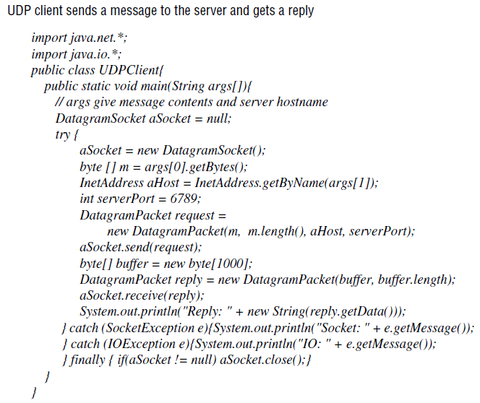

Slide 29
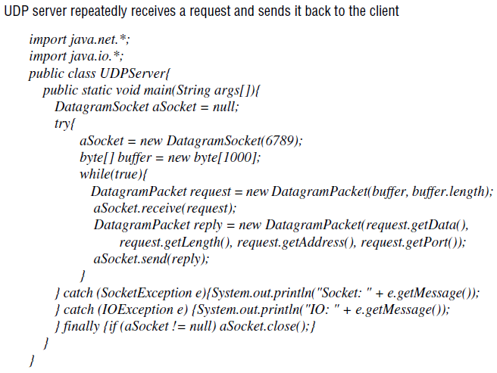

Slide 30
TCP stream communication
The API to the TCP protocol, which originates from BSD 4.x UNIX, provides the abstraction of a stream of bytes to which data may be written and from which data may be read. The following characteristics of the network are hidden by the stream abstraction:
Message sizes: The application can choose how much data it writes to a stream or reads from it. It may deal in very small or very large sets of data. The underlying implementation of a TCP stream decides how much data to collect before transmitting it as one or more IP packets. On arrival, the data is handed to the application as requested. Applications can, if necessary, force data to be sent immediately.

Slide 31
TCP stream communication (cont.)
Lost messages: The TCP protocol uses an acknowledgement scheme. As an example of a simple scheme (which is not used in TCP), the sending end keeps a record of each IP packet sent and the receiving end acknowledges all the arrivals.
If the sender does not receive an acknowledgement within a timeout, it retransmits the message. The more sophisticated sliding window scheme [Comer 2006] cuts down on the number of acknowledgement messages required.
Flow control: The TCP protocol attempts to match the speeds of the processes that read from and write to a stream. If the writer is too fast for the reader, then it is blocked until the reader has consumed sufficient data.

Slide 32
TCP stream communication (cont.)
Message duplication and ordering: Message identifiers are associated with each IP packet, which enables the recipient to detect and reject duplicates, or to reorder messages that do not arrive in sender order.
Message destinations: A pair of communicating processes establish a connection before they can communicate over a stream. Once a connection is established, the processes simply read from and write to the stream without needing to use Internet addresses and ports. Establishing a connection involves a connect request from client to server followed by an accept request from server to client before any communication can take place. This could be a considerable overhead for a single client-server request and reply.

Slide 33
TCP stream communication (cont.)
The API for stream communication assumes that when a pair of processes are establishing a connection, one of them plays the client role and the other plays the server role, but thereafter they could be peers. The client role involves creating a stream socket bound to any port and then making a connect request asking for a connection to a server at its server port.
The server role involves creating a listening socket bound to a server port and waiting for clients to request connections. The listening socket maintains a queue of incoming connection requests. In the socket model, when the server accepts a connection, a new stream socket is created for the server to communicate with a client, meanwhile retaining its socket at the server port for listening for connect requests from other clients.

Slide 34
TCP stream communication (cont.)
The pair of sockets in the client and server are connected by a pair of streams, one in each direction. Thus each socket has an input stream and an output stream.
One of the pair of processes can send information to the other by writing to its output stream, and the other process obtains the information by reading from its input stream.
When an application closes a socket, this indicates that it will not write any more data to its output stream. Any data in the output buffer is sent to the other end of the stream and put in the queue at the destination socket, with an indication that the stream is broken. The process at the destination can read the data in the queue, but any further reads after the queue is empty will result in an indication of end of stream. When a process exits or fails, all of its sockets are eventually closed and any process attempting to communicate with it will discover that its connection has been broken.

Slide 35
TCP stream communication (cont.)
The following are some outstanding issues related to stream communication:
Matching of data items: Two communicating processes need to agree as to the contents of the data transmitted over a stream.
For example, if one process writes an int followed by a double to a stream, then the reader at the other end must read an int followed by a double.
When a pair of processes do not cooperate correctly in their use of a stream, the reading process may experience errors when interpreting the data or may block due to insufficient data in the stream.

Slide 36
TCP stream communication- related issues (cont.)
Blocking: The data written to a stream is kept in a queue at the destination socket. When a process attempts to read data from an input channel, it will get data from the queue or it will block until data becomes available. The process that writes data to a stream may be blocked by the TCP flow-control mechanism if the socket at the other end is queuing as much data as the protocol allows.
Threads: When a server accepts a connection, it generally creates a new thread in which to communicate with the new client. The advantage of using a separate thread for each client is that the server can block when waiting for input without delaying other clients. In an environment in which threads are not provided, an alternative is to test whether input is available from a stream before attempting to read it; for example, in a UNIX environment the select system call may be used for this purpose.

Slide 37
Failure model for TCP stream communication
To satisfy the integrity property of reliable communication, TCP streams use checksums to detect and reject corrupt packets and sequence numbers to detect and reject duplicate packets.
For the sake of the validity property, TCP streams use timeouts and retransmissions to deal with lost packets. Therefore, messages are guaranteed to be delivered even when some of the underlying packets are lost.
But if the packet loss over a connection passes some limit or the network connecting a pair of communicating processes is severed or becomes severely congested, the TCP software responsible for sending messages will receive no acknowledgements and after a time will declare the connection to be broken. Thus TCP does not provide reliable communication, because it does not guarantee to deliver messages in the face of all possible difficulties.

Slide 38
Failure model for TCP stream communication (cont.)
When a connection is broken, a process using it will be notified if it attempts to read or write. This has the following effects:
The processes using the connection cannot distinguish between network failure and failure of the process at the other end of the connection.
The communicating processes cannot tell whether the messages they have sent recently have been received or not.

Slide 39
Use of TCP
Many frequently used services run over TCP connections, with reserved port numbers. These include the following:
HTTP: The Hypertext Transfer Protocol is used for communication between web browsers and web servers.
FTP: The File Transfer Protocol allows directories on a remote computer to be browsed and files to be transferred from one computer to another over a connection.
Telnet: Telnet provides access by means of a terminal session to a remote computer.
SMTP: The Simple Mail Transfer Protocol is used to send mail between computers.

Slide 40
Java API for TCP streams
The Java interface to TCP streams is provided in the classes ServerSocket and Socket:
ServerSocket: This class is intended for use by a server to create a socket at a server port for listening for connect requests from clients. Its accept method gets a connect request from the queue or, if the queue is empty, blocks until one arrives. The result of executing accept is an instance of Socket – a socket to use for communicating with the client.
Socket: This class is for use by a pair of processes with a connection. The client uses a constructor to create a socket, specifying the DNS hostname and port of a server. This constructor not only creates a socket associated with a local port but also connects it to the specified remote computer and port number. It can throw an UnknownHostException if the hostname is wrong or an IOException if an IO error occurs.

Slide 41
Java API for TCP streams (cont.)
The Socket class provides the methods getInputStream and getOutputStream for accessing the two streams associated with a socket.
The return types of these methods are InputStream and OutputStream, respectively – abstract classes that define methods for reading and writing bytes. The return values can be used as the arguments of constructors for suitable input and output streams. Our example uses DataInputStream and DataOutputStream, which allow binary representations of primitive data types to be read and written in a machine-independent manner.
Figure shows a client program in which the arguments of the main method supply a message and the DNS hostname of the server. The client creates a socket bound to the hostname and server port 7896. It makes a DataInputStream and a DataOutputStream from the socket’s input and output streams, then writes the message to its output stream and waits to read a reply from its input stream.

Slide 42
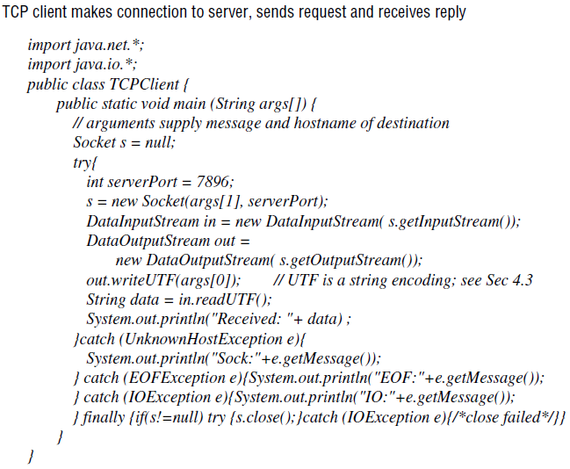

Slide 43
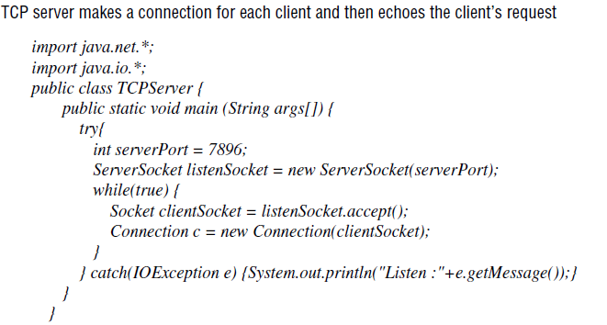

Slide 44
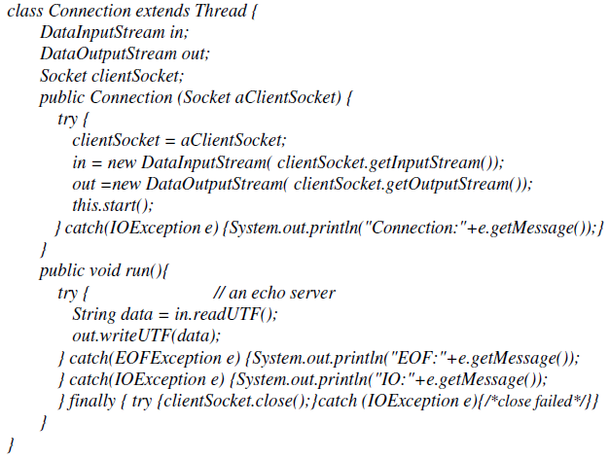

Slide 45
Java API for TCP streams (cont.)
The server program opens a server socket on its server port (7896) and listens for connect requests. When one arrives, it makes a new thread in which to communicate with the client. The new thread creates a DataInputStream and a DataOutputStream from its socket’s input and output streams and then waits to read a message and write the same one back.
As our message consists of a string, the client and server processes use the method writeUTF of DataOutputStream to write it to the output stream and the method readUTF of DataInputStream to read it from the input stream.
When a process has closed its socket, it will no longer be able to use its input and output streams. The process to which it has sent data can read the data in its queue, but any further reads after the queue is empty will result in an EOFException. Attempts to use a closed socket or to write to a broken stream result in an IOException.

Slide 46
External Data Representation and Marshalling
The information stored in running programs is represented as data structures – for example, by sets of interconnected objects – whereas the information in messages consists of sequences of bytes.
Irrespective of the form of communication used, the data structures must be flattened (converted to a sequence of bytes) before transmission and rebuilt on arrival.
The individual primitive data items transmitted in messages can be data values of many different types, and not all computers store primitive values such as integers in the same order. The representation of floating-point numbers also differs between architectures.

Slide 47
External Data Representation and Marshalling (cont.)
There are two variants for the ordering of integers: the so-called big-endian order, in which the most significant byte comes first; and little-endian order, in which it comes last.
Another issue is the set of codes used to represent characters: for example, the majority of applications on systems such as UNIX use ASCII character coding, taking one byte per character, whereas the Unicode standard allows for the representation of texts in many different languages and takes two bytes per character.

Slide 48
External Data Representation and Marshalling (cont.)
One of the following methods can be used to enable any two computers to exchange binary data values:
The values are converted to an agreed external format before transmission and converted to the local form on receipt; if the two computers are known to be the same type, the conversion to external format can be omitted.
The values are transmitted in the sender’s format, together with an indication of the format used, and the recipient converts the values if necessary.

Slide 49
External Data Representation and Marshalling (cont.)
Bytes themselves are never altered during transmission. To support RMI or RPC, any data type that can be passed as an argument or returned as a result must be able to be flattened and the individual primitive data values represented in an agreed format. An agreed standard for the representation of data structures and primitive values is called an external data representation.
Marshalling is the process of taking a collection of data items and assembling them into a form suitable for transmission in a message. Unmarshalling is the process of disassembling them on arrival to produce an equivalent collection of data items at the destination. Thus marshalling consists of the translation of structured data items and primitive values into an external data representation. Similarly, unmarshalling consists of the generation of primitive values from their external data representation and the rebuilding of the data structures.

Slide 50
External Data Representation and Marshalling (cont.)
Three alternative approaches to external data representation and marshalling are:
CORBA’s common data representation, which is concerned with an external representation for the structured and primitive types that can be passed as the arguments and results of remote method invocations in CORBA. It can be used by a variety of programming languages.
Java’s object serialization, which is concerned with the flattening and external data representation of any single object or tree of objects that may need to be transmitted in a message or stored on a disk. It is for use only by Java.

Slide 51
External Data Representation and Marshalling- alternative approaches (cont.)
XML (Extensible Markup Language), which defines a textual format for representing structured data. It was originally intended for documents containing textual self-describing structured data – for example documents accessible on the Web – but it is now also used to represent the data sent in messages exchanged by clients and servers in web services.

Slide 52
External Data Representation and Marshalling- alternative approaches (cont.)
In the first two cases, the marshalling and unmarshalling activities are intended to be carried out by a middleware layer without any involvement on the part of the application programmer. Even in the case of XML, which is textual and therefore more accessible to hand-encoding, software for marshalling and unmarshalling is available for all commonly used platforms and programming environments. Because marshalling requires the consideration of all the finest details of the representation of the primitive components of composite objects, the process is likely to be error-prone if carried out by hand. Compactness is another issue that can be addressed in the design of automatically generated marshalling procedures.

Slide 53
External Data Representation and Marshalling- alternative approaches (cont.)
In the first two approaches, the primitive data types are marshalled into a binary form. In the third approach (XML), the primitive data types are represented textually. The textual representation of a data value will generally be longer than the equivalent binary representation. The HTTP protocol is another example of the textual approach.
Another issue with regard to the design of marshalling methods is whether the marshalled data should include information concerning the type of its contents. For example, CORBA’s representation includes just the values of the objects transmitted, and nothing about their types. On the other hand, both Java serialization and XML do include type information, but in different ways. Java puts all of the required type information into the serialized form, but XML documents may refer to externally defined sets of names (with types) called namespaces.

Slide 54
External Data Representation and Marshalling- alternative approaches (cont.)
Although we are interested in the use of an external data representation for the arguments and results of RMIs and RPCs, it does have a more general use for representing data structures, objects or structured documents in a form suitable for transmission in messages or storing in files.

